Slide 1

Agenda for Sync Session #1
Welcome
Syllabus Review
Answer Questions / Clarify Anything
How we’ll Communicate!
Important Dates
Expectations
How to use the PowerPoints & Other Resources
Introductions (You!) & Key Learnings

Slide 2

Syllabus Review

Slide 3

Communicating!
Sakai
  Message Feature!
  Discussions (To Share)
Phone: 708-805-2368

Slide 4
Important Dates
June 29 – Aug. 7 2020
2 Synch Sessions (CST):
  Monday (6-7:30pm) 7/13
  Monday, 6-7:30pm) 7/21
Academic Week: Sun – Sat
Sat Midnight – Due date – unless other specified!

Slide 5


1
Understanding Human Communication 13/e
Communication: What & Why

Slide 6
Example of Activity for SS#1

Slide 7

Your Turn:
Take a 5 min. break to prepare
Return and:
1) Introduce yourself
(2) Share a Key Learning from Chapters 1 or 2
Total of 60 seconds, please!

Slide 8
Example of Activity for SS#2

Slide 9


6
Understanding Human Communication 13/e
Nonverbal Communication

Slide 10
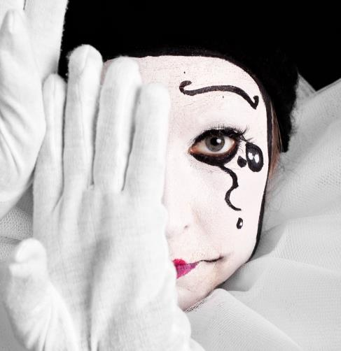
Key Concepts /Axioms
Nonverbal communication:
Exists!
Is Powerful (93% of Message)
Relational
Ambiguous
Cultural

Slide 11

Types of Nonverbals!
Appearance
Artifacts
Chronemics
Haptics
Oculesics
Olfactics
Posture
Proxemics
Vocalics
(7 min. – Prepare a Definition + Demonstration)

